Slide 1



Scotland’s Independence Referendum: The Economic Issues
David Bell

Slide 2
Outline
Main economic issues
Psychology and the Yes/No decision
Business views on the referendum
Economics of Secession – useful in the Scottish context?

Slide 3
Economic Issues
Scottish referendum debate was primarily focussed on economic issues
Key arguments from the “Yes” campaign
  An independent Scottish Government could deliver faster rates of economic growth
  An independent Scottish Government could provide policies that focussed more on “social justice”, “fairness” and “equality”.
The Yes campaign focussed more on policies than powers
The No campaign was divided over powers and over policies. There was no coherence in its offering

Slide 4
Key economic issues: Currency
Options
  Formally share the pound
  Informally share the pound
  Scotland creates its own currency
  Scotland joins the Euro
Yes campaign preference – formally share the pound
Rejected by UK government and all UK political parties
Yes campaign did not produce an alternative –a “Plan B”

Slide 5
Key economic issues: North Sea Oil
North Sea Oil revenues have been of substantial value to UK Government finances
They are now in decline, because most fields are exhausted
The Yes campaign view: the North Sea can be made to thrive once again, given the right tax environment
The No campaign view: oil revenues are volatile and in long-term decline. They cannot be relied on as a significant support to the Scottish economy in the long-run
Both sides assert their view: no resolution possible

Slide 6
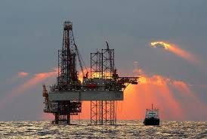
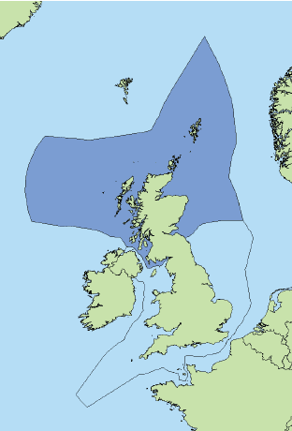
North Sea Oil Revenues
Scotland’s “geographical”
share

Slide 7
Fiscal sustainability – serious indebtedness
Fiscal deficit
Borrowing required
1p on basic rate income tax raises between £208m and £395m

Slide 8
Other important economic issues:
Border effects
Pensions (State, Public and Private)
Allocation of National Debt
Migration
Costs of Transition

Slide 9
Please rate on a scale of 0-10 how important the following factors are in deciding how you are going to vote in a referendum on Scottish Independence Please answer on the following 0 to 10 scale where 0 is 'not at all important' and 10 is 'extremely important’

Slide 10
Economic issues judged more important in determining voting preference..

Slide 11
“Yes” as well as “No” voters thought their tax position would deteriorate with independence

Slide 12
Pensions also expected to be worse with independence

Slide 13
Did Psychological Traits
Influence Voting Intentions?
Willingness to take risks
Concern about the future
Wish to see Scotland as a “fairer” society
Mobility

Slide 14
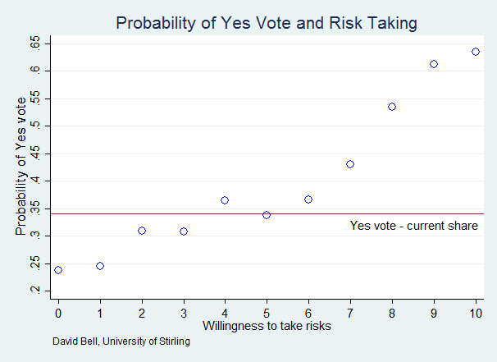
Willingness to Take Risks Forecasts Voting Intention

Slide 15
But future-orientation not a good predictor
Often I engage in a particular behaviour in order to achieve
outcomes that may not result for many years.

Slide 16
Yes voters slightly more liberal on state benefits
A £500 a week limit has been introduced on the amount of benefits a
non-working household can receive. Where would you set the weekly limit?

Slide 17
No difference in mobility between Yes and No voters
How long have you lived at your address?

Slide 18
Business Attitudes
Many firms unwilling to commit
Did not want to antagonise customers (especially Scottish Government), shareholders or employees
Business organisations, with the exception of the Confederation of British Industry, largely avoided taking sides, even when there was clear evidence that business sentiment was generally against secession
Most opposition came from financial sector: several firms moved or threatened to move their company offices from Edinburgh to London

Slide 19
Important issues for business …
Source: Second SCC Survey - Feb 2014

Slide 20
Economics of Secession
Alesina and Spoloare, authors of “The Size of Nations”, argue that “preference heterogeneity” is a principal motivating factor for secession
This term is shorthand for the linguistic, social, ethnic, cultural or historical differences that may exist between groups of citizens within a sovereign state
These factors largely static or slow-moving

Slide 21
Trends in responses to identity questions

Slide 22
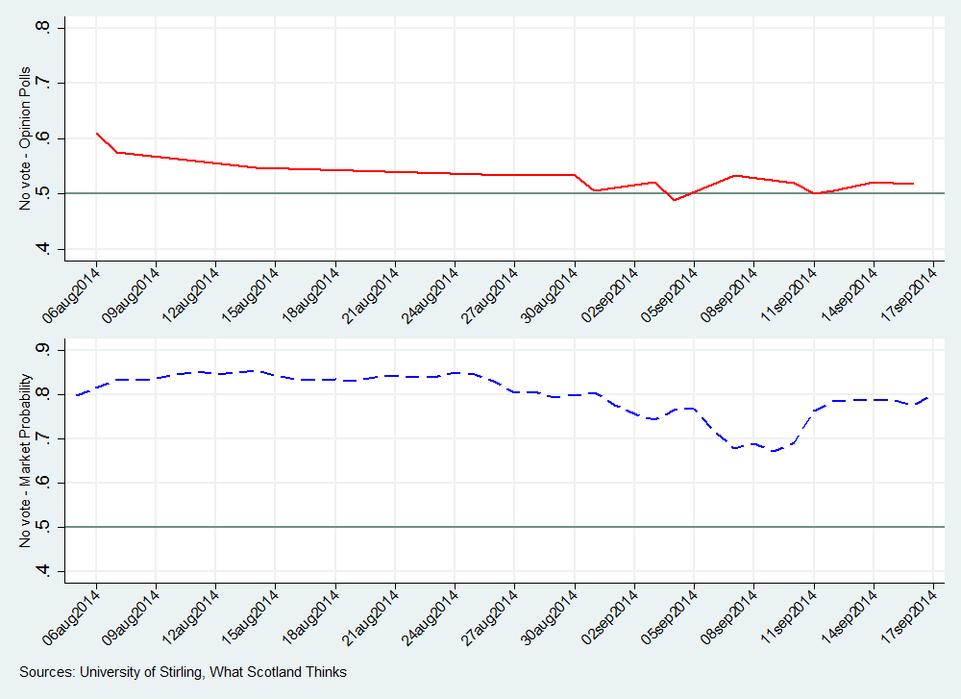
The opinion polls wavered, but the bookmakers were always fairly sure of the outcome

Slide 23
So why did the opinion polls close?
  No evidence of preference heterogeneity
  Confusion about whether referendum about powers or about policies. Yes campaign able to focus on policies: no agreement among the parties to No campaign
  Herd effects?
    risk neutral individuals decide in sequence whether to adopt or reject a possible action
    behaviour is idiosyncratic - the choices of a few early individuals may determine the choices of all successors
    Reinforced by effective grass-roots campaigning
    May explain Yes momentum in last few weeks

